Slide 1

COMMUNICATION PROCESSES
Notes:
Communication processes refers to the steps that are taken to successfully pass message from the sender to the receiver.

Slide 2
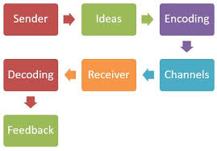
Major Communication Processes between Individuals and Organizations
Introduction
Communication refers to a process through which information is passed from the sender to the receiver.
Communication involves use of mutually understood signs, symbols, and semiotic rules (Geldard, 2014).
The process of communication involves encoding, planning, choosing of the medium to be used, decoding and feedback.
Notes:
Communication is carried between the sender and the receiver. Any act that entails one individual giving or receiving from another person information concerning the individual’s perceptions, knowledge, desires or needs is referred to as communication.

Slide 3

Basic Communication Process
Sender
Decides the message to be conveyed to the receiver.
Encodes the information using symbols in such a way that the receiver will understand the message.
Converts the message into signal.
After having decided and organized the message to be send, the sender sends its over a communication channel that seems to be suitable (Guffey& Loewy, 2011).
Notes:
The sender is the person from whom the process of communication begins. The sender comes up with the message after which it is conveyed to the receiver through an appropriate media.

Slide 4

Communication Channel
Communication channel refers to a transmission medium through which the information to be communicated passes through (Guffey et al., 2011).
There are exists several types of communication channel. Some of the communication channels include:
Person’s voice
Written medium
Video medium.
Notes:
A communication channel is a medium through which a message is passed from one person to another or rather from the sender to the receiver.

Slide 5
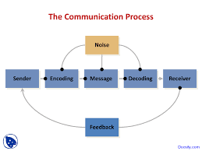
Noise
Noise refers to anything that has a disturbing influence on the information being conveyed.
Since noise is making the communication process to be ineffective, then the sender must choose a channel that is free from noise.
Notes:
The sender must pick a communication channel that is free from noise so that the process can be effective.

Slide 6
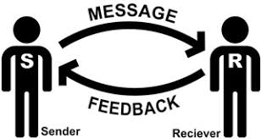
Receiver
The receiver in a communication process refers to the person who is either listening, observing or reading (Guffey et al., 2018).
The receiver in simple terms can be said to be the person to whom information is directed .
Notes:
The receiver is the person to whom information or message is directed. The sender conveys information through a channel to the receiver.

Slide 7
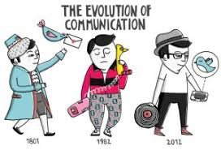
Communication Media
Communication media refers to the means of delivering and receiving the intended information or message (Guffey et al., 2018).
Some of the communication media are;
Telephone
Electronic mail
Letter or memorandum
Videoconference
Internet chat rooms
Face-to-face meetings
Notes:
Channels of communication refers to ways or means through which communication is conveyed from the sender to the receiver.

Slide 8

Choosing Medium
There exists many communication mediums and a sender must choose the most appropriate one.
Some of the communication medium include:
Written medium. Written medium is best for formality and clear messages.
Face-to-face. It is best for conveying a sense of teamwork.
E-mail. Its use is based on availability and ease of use to the receiver.
Notes:
The medium of communication must be chosen wisely. It must be familiar by the person to whom the message is directed.

Slide 9
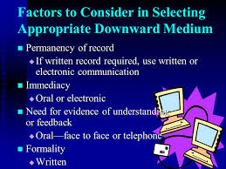
Factors to Consider when Choosing a Communication Medium
Some of the factors to consider when choosing a communication medium include:
Nature of medium; the communication of medium used to transmit a message depends on the nature of the message. The nature of a message can be urgency, confidentiality, and private.
Cost; the sender should consider the cost of sending information through a certain medium. The results should justify the cost incurred.
Record; if there is a need for a record then the medium should be the written one, otherwise communication will be insufficient.
Notes:
The communication medium selected by a sender should be appropriate so that there can be effective communication.

Slide 10

Cont…,
Distance; the medium of communication depends on whether the information is to be sent to a nearby place or not.
Scale of organization; communication in small-scale businesses is done via oral while on large businesses is done via written means.
Supporting technology; both the sender and the receiver must have a kind of technology that will support the communication that is send via a certain medium.
Urgency; if the message is required as soon as possible, it should be conveyed through a mean that will deliver it faster.
Notes:
Communication should be carried out in a manner that it effectively passes the intended information from the sender to the receiver on the other side.

Slide 11
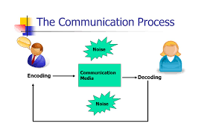
Feedback
Feedback refers to the message that the receiver generates after receiving the initial message from the sender.
Feedback is usually important since it ensures that the message was understood by the receiver.
If the message was not understood, then the sender can change the version or can add additional information for clarification purposes.
Notes:
Feedback ensures that the receiver understood the message. If the sender notices otherwise, he or she should add additional information so that he or she can clarify.

Slide 12
References
Geldard, F. A. (2014). Communication Processes: Proceedings of a Symposium Held in Washington, 1963. Kent: Elsevier Science.
Guffey, M. E., & Loewy, D. (2011). Business communication: Process and product. Mason, Ohio: South-Western.
Guffey, M. E., & Loewy, D. (2018). Business Communication: Process et Product.

